Slide 1
Parameter Estimation
CSGE602013 – Statistics and Probability
Fakultas Ilmu Komputer
Universitas Indonesia

Slide 2
References
Introduction to Probability and Statistics for Engineers & Scientists, 4th ed.,
Sheldon M. Ross, Elsevier, 2009.
Applied Statistics and Probability for Engineeris, 3rd ed.,
Douglas C. Montgomery, George C. Runger, John Wiley & sons Inc.
A First Course in Probability, 8th Edition.
Sheldon M. Ross
Probability and Statistics for Engineers & Scientists, 4th Edition
Anthony J. Hayter, Thomson Higher Education

Slide 3
Outline
Introduction
Interval Estimates
Confidence Interval
Estimating the Difference in Means of Two Normal Populations
Approximate Confidence Interval for the Mean of a Bernoulli Random Variable

Slide 4
Parametric vs Non-Parametric Inference Problem
Parametric inference problem: F is specified up to a set of unknown parameters
Nonparametric inference problem: nothing is assumed about F

Slide 5
Introduction
Let X₁, X₂, ..., X_{n} be a random sample from a population that has distribution F_{θ}.
The distribution F_{θ} is specified up to a vector of parameters θ₁, θ₂, θ₃, ..., θ_{k}.
BUT, those parameters are unknown !!
This chapter talks about how to estimate those parameters using statistics from sample.
Yes...Inferential statistics....in parametric model

Slide 6
Introduction
In probability theory, it is usual to suppose that all of the parameters of a distribution are known.
The opposite is true in statistics...
In statistics, the central problem is to use the observed data (sample) to make inferences about the unknown parameters.

Slide 7
Estimator & Estimates
Any statistic used to estimate the value of an unknown parameter θ is called an estimator of θ.
The observed value of the estimator is called the estimate.
There are two types of estimates:
Point estimate, using Maximum Likelihood Estimator (MLE)
Interval estimate

Slide 8
Estimator & Estimates
Interval Estimate
In this case, rather than specifying a certain value as our estimate of θ, we specify an interval in which we estimate θ that lies.
Moreover, we also consider the question of how much confidence we can attach to such an interval estimate.

Slide 9
Interval Estimates

Slide 10
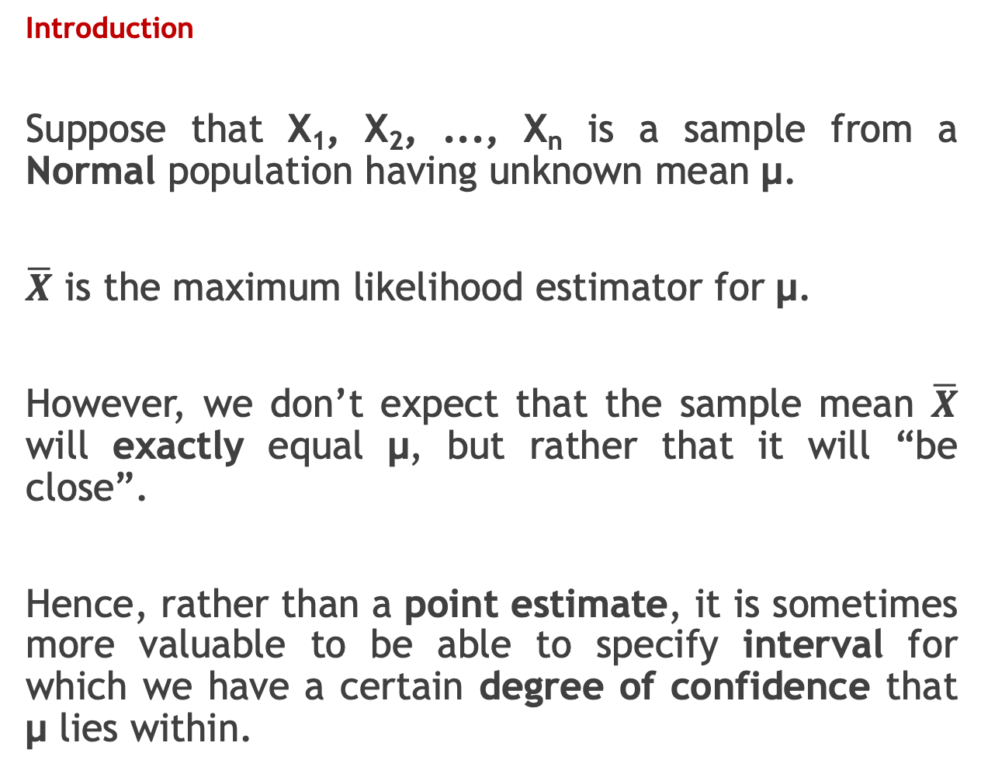
Introduction
Suppose that X₁, X₂, ..., X_{n} is a sample from a Normal population having unknown mean μ.
$\overline{X}$ is the maximum likelihood estimator for μ.
However, we don’t expect that the sample mean $\overline{X}$ will exactly equal μ, but rather that it will “be close”.
Hence, rather than a point estimate, it is sometimes more valuable to be able to specify interval for which we have a certain degree of confidence that μ lies within.

Slide 11
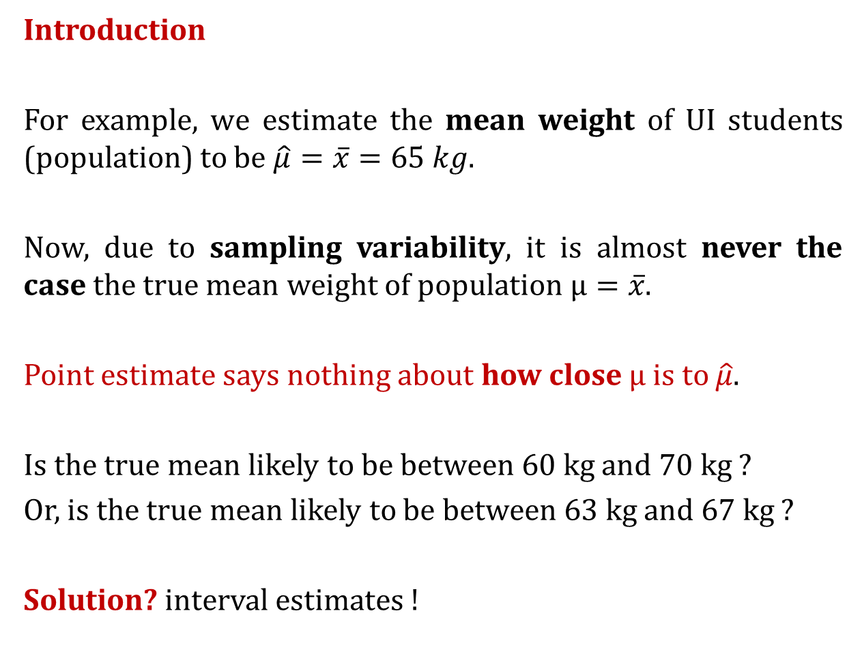
Introduction
For example, we estimate the mean weight of UI students (population) to be $\hat{μ}=\overline{x}=65 kg$.
Now, due to sampling variability, it is almost never the case the true mean weight of population $μ=\overline{x}$.
Point estimate says nothing about how close $μ$ is to $\hat{μ}$.
Is the true mean likely to be between 60 kg and 70 kg ?
Or, is the true mean likely to be between 63 kg and 67 kg ?
Solution? interval estimates !
[Montgomery & Runger, 2002]
Notes:
Kalau point estimate => Nggak dapat sensenya seberapa jauh sih rataan populasi yang sebenarnya dengan rataan sample ? (tidak ada uncertainty)
A point estimate by itself is of limited usefulness because it does not reveal the uncertainty associated with the estimate; you do not have a good sense of how far this sample mean may be from the population mean. For example, can you be confident that the population mean is within 5 pounds of 90? You simply do not know.
Confidence intervals provide more information than point estimates.

Slide 12
Introduction
Interval estimate give bounds that represent an interval of plausible values for a parameter.
An interval estimate for a population parameter is called confidence interval (CI).
We cannot be certain that the interval contains the true, unknown population parameter.
However, the confidence interval is constructed so that we have high confidence that it does contain the unknown population parameter.
[Montgomery & Runger, 2002]
Notes:
Kalau point estimate => Nggak dapat sensenya seberapa jauh sih rataan populasi yang sebenarnya dengan rataan sample ? (tidak ada uncertainty)
A point estimate by itself is of limited usefulness because it does not reveal the uncertainty associated with the estimate; you do not have a good sense of how far this sample mean may be from the population mean. For example, can you be confident that the population mean is within 5 pounds of 90? You simply do not know.
Confidence intervals provide more information than point estimates.

Slide 13
Sub-topics
Normal Population
One Normal Population
Confidence Interval for a Normal Mean when the Variance is known
Confidence Interval for a Normal Mean when the Variance is unknown
Two Normal Populations
Confidence Interval for the difference in means of two normal populations, when variances of two populations are known.
Confidence Interval for the difference in means of two normal populations, when variances of two populations are unknown, but equal variances.
Bernoulli Random Variable
Confidence Interval for the mean of a Bernoulli R.V.

Slide 14
Interval Estimates
Sample is obtained from one normal population
Confidence Interval for a Normal Mean when the Variance is known
Confidence Interval for a Normal Mean when the Variance is unknown

Slide 15
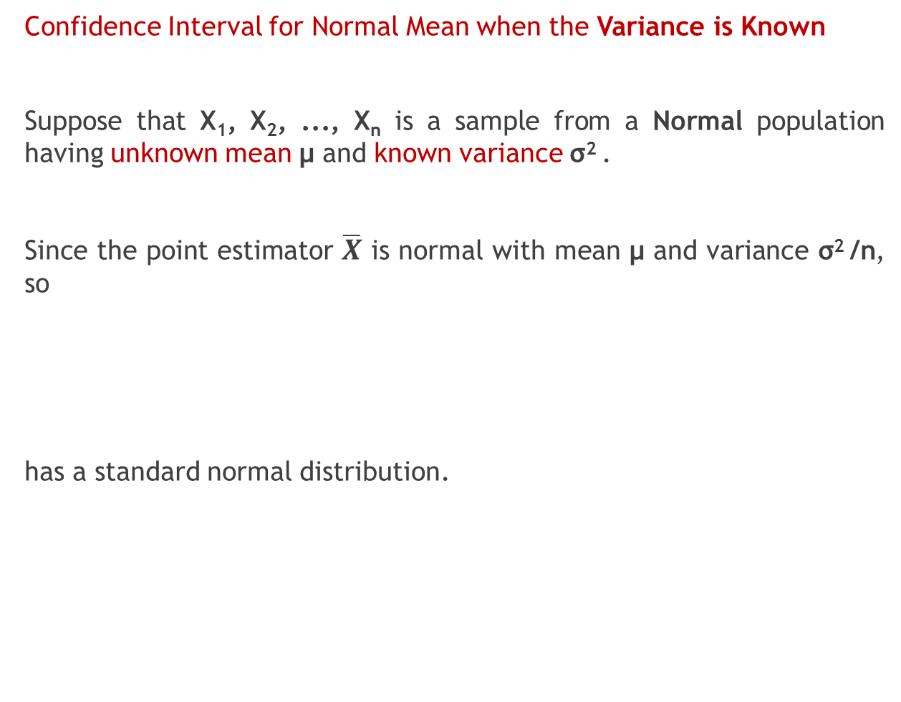
Confidence Interval for Normal Mean when the Variance is Known
Suppose that X₁, X₂, ..., X_{n} is a sample from a Normal population having unknown mean μ and known variance σ² .
Since the point estimator $\overline{X}$ is normal with mean μ and variance σ² /n, so
has a standard normal distribution.

Slide 16
Confidence Interval for Normal Mean when the Variance is Known
Recall that for standard normal distribution
Hence,

Slide 17
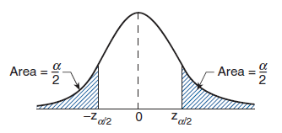
Confidence Interval for Normal Mean when the Variance is Known

Slide 18
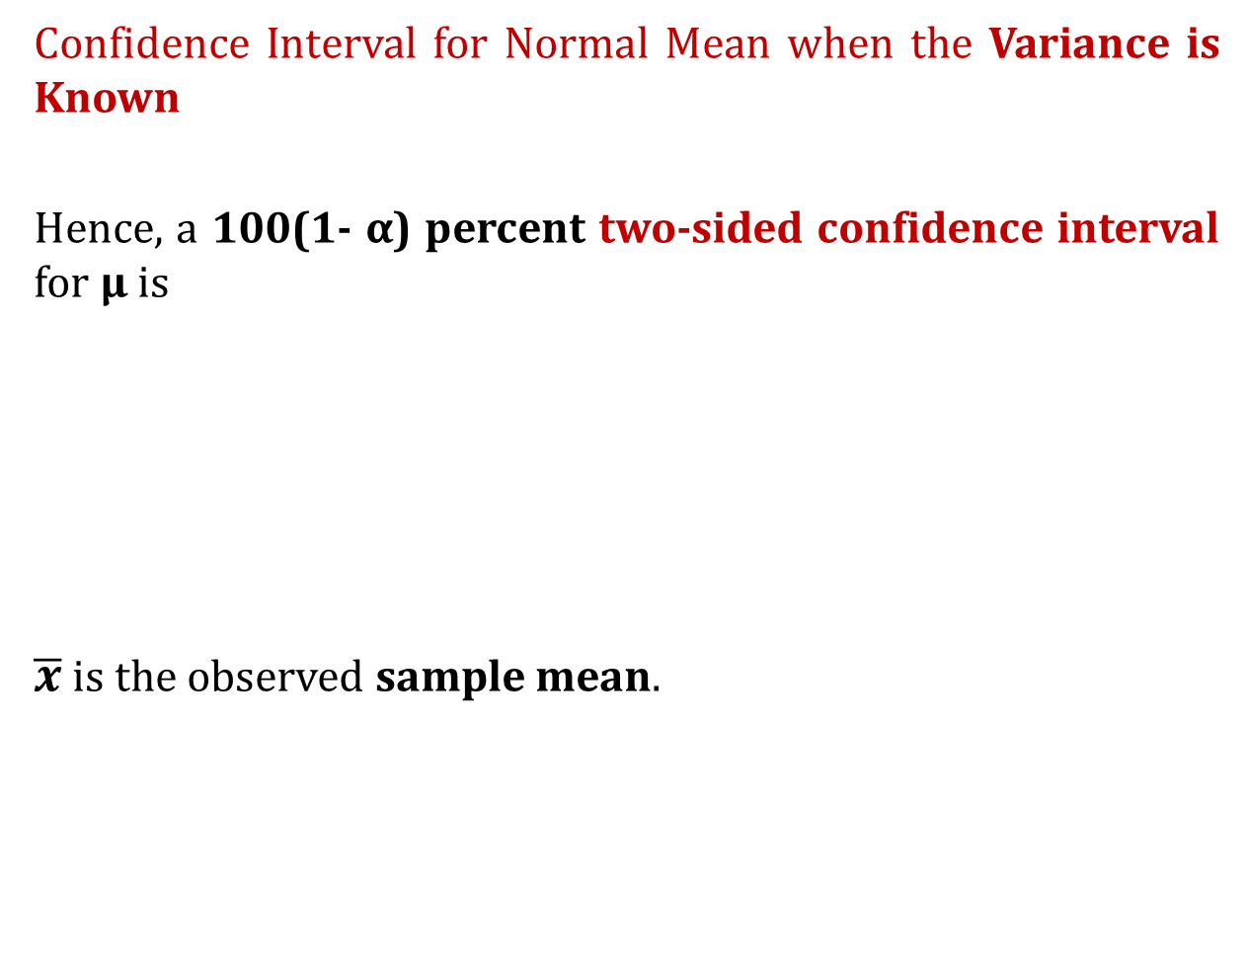
Confidence Interval for Normal Mean when the Variance is Known
Hence, a 100(1- α) percent two-sided confidence interval for μ is
$\overline{x}$ is the observed sample mean.

Slide 19
Confidence Interval for Normal Mean when the Variance is Known
We can also write the previous interval as
Here,
Ketika ukuran sampel n semakin besar, maka margin of error akan semakin kecil dan confidence interval juga akan semakin mengecil.
MOE = Margin of Error

Slide 20
Sebenarnya, apa sih maksud dari 99% CI berikut ?
[Pilihan Berganda] What is the best interpretation of the above 99% CI for the population mean ?
μ is within interval (7.28, 10.72), which is computed as our 99% CI, with probability 0.99
If repeated samples were taken and the 99% CI was computed for each sample using the same method, 99% of the intervals would contain the population mean.
Misal, diberikan sample, kita hitung 99% two-sided CI untuk μ :
Ini yang lebih tepat ! ☺
[Montgomery & Runger, 2002]
Notes:
Yang (b) tepat
Dari beberapa 99% CI yang dihitung dari beberapa sample, dengan 99% mengandung true mean of population (probabilitas 0.99)
Artinya, peluang saya mengambil satu 99% CI yang mengandung true mean population adalah 0.99
Yang (a) nggak tepat karena
For example, if numerous prior studies had all found sample means above 11, it would not make sense to conclude that there is a 0.99 probability that the population mean is between 7.28 and 10.72. => ini karena tiap kali kita ambil sample yang baru lagi, maka interval 99% CI-nya pasti beda lagi. Jadi, tidak tepat jika probabilitas ini hanya disematkan pada SEBUAH pengambilan sample aja.
http://onlinestatbook.com/2/estimation/confidence.html

Slide 21
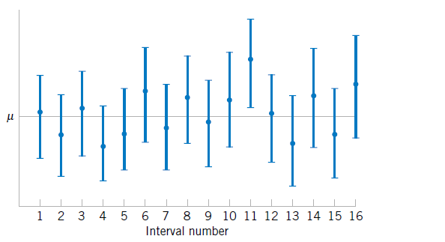
Sebenarnya, apa sih maksud dari 100(1-α)% CI ?
Ada 1 CI yang tidak mengandung μ sesungguhnya
Random Interval
Raatan sampel
Nilai μ sesungguhnya
Repeated construction of a Confidence Interval for μ, using different samples from the same population
A CI estimate may or may not contain the value of parameter being estimated !
[Montgomery & Runger, 2002]
Notes:
Yang (b) tepat
Dari beberapa 99% CI yang dihitung dari beberapa sample, dengan 99% mengandung true mean of population (probabilitas 0.99)
Artinya, peluang saya mengambil satu 99% CI yang mengandung true mean population adalah 0.99
Yang (a) nggak tepat karena
For example, if numerous prior studies had all found sample means above 11, it would not make sense to conclude that there is a 0.99 probability that the population mean is between 7.28 and 10.72. => ini karena tiap kali kita ambil sample yang baru lagi, maka interval 99% CI-nya pasti beda lagi. Jadi, tidak tepat jika probabilitas ini hanya disematkan pada SEBUAH pengambilan sample aja.
http://onlinestatbook.com/2/estimation/confidence.html

Slide 22
Sebenarnya, apa sih maksud dari 99% CI berikut ?
Secara praktis, kita hanya menggunakan sebuah random sample untuk menghitung confidence interval.
Lalu apa statement yang tepat untuk, misal, 99% CI berikut ?
“The observed interval (7.28, 10.72) brackets the true value of μ with confidence 99%.”
“Berdasarkan sample yang didapatkan, interval (7.28, 10.72) mengandung nilai μ yang sesungguhnya dengan keyakinan 99%”
[Montgomery & Runger, 2002]
Notes:
Tuliskan secara umumnya.

Slide 23


Confidence Interval for Normal Mean when the Variance is Known
Sometimes, we are interested in an upper limit of the population mean μ or a lower limit of μ.
In this case, one-sided confidence intervals are appropriate.
One-sided upper CI
One-sided lower CI
Lower limit
α
(1- α)
$$∞$$
μ
Upper limit
α
(1- α)
$$−∞$$
μ

Slide 24
Confidence Interval for Normal Mean when the Variance is Known
Sometimes, we are interested in determining a value so that we can assert with, say, 100(1 - α) percent confidence, that μ is at least as large as that value (lower limit value).
How to determine one-sided upper CI

Slide 25
Confidence Interval for Normal Mean when the Variance is Known
Hence, a 100(1 - α) percent one-sided upper confidence interval for μ is
Similary, a 100(1 - α) percent one-sided lower confidence interval for μ is
Lower limit of μ
Upper limit of μ
Using the fact that
Notes:
Ternyata di literatur lain, ini upper dan lower-nya ada yang dibalik ☺

Slide 26
Confidence Interval for Normal Mean when the Variance is Known
Summary, for 100(1 - α)% confidence
Two-Sided CI
One-Sided Upper CI
One-Sided Lower CI
Notes:
Perlu disampaikan maksud dari angka Two-sided Ci apa ? One-sided upper CI apa ? One-sided lower CI apa ?
Upper : lebih bermanfaat untuk melihat -> we assert with, say, 95% confidence, that mean is at least as large as that value

Slide 27
Confidence Interval for Normal Mean when the Variance is Known
for 95% confidence
Two-Sided CI
One-Sided Upper CI
One-Sided Lower CI

Slide 28
Confidence Interval for Normal Mean when the Variance is Known
Example 1
Suppose that when a signal having value μ is transmitted from location A the value received at location B is normally distributed with mean μ and variance 4. That is, if μ is sent, then the value received is μ + N where N, representing noise, is normal with mean 0 and variance 4. To reduce error, suppose the same value is sent 9 times.
If the successive values received are 5, 8.5, 12, 15, 7, 9, 7.5, 6.5, 10.5, construct:
95% CI for μ (two-sided, one-sided upper/lower CI)
99% CI for μ (two-sided, one-sided upper/lower CI)

Slide 29
Confidence Interval for Normal Mean when the Variance is Known
Since,
95% two-sided CI for μ is
95% one-sided upper CI for μ is
95% one-sided lower CI for μ is

Slide 30
Confidence Interval for Normal Mean when the Variance is Known
From table,
99% two-sided CI for μ is
99% one-sided upper CI for μ is
99% one-sided lower CI for μ is

Slide 31
Confidence Interval for Normal Mean when the Variance is Unknown
In this case, σ is unknown !
Therefore, we can’t use previous formulas to estimate μ.
We need to use t-distribution instead of z-distribution
Using the similar procedure as before, we then start from the following corollary:

Slide 32
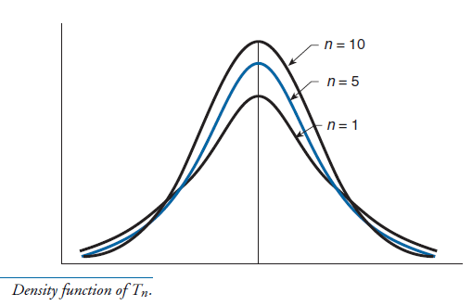
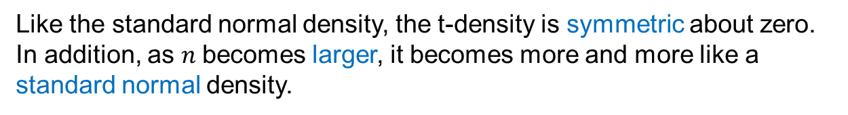
The t-Distribution
Like the standard normal density, the t-density is symmetric about zero. In addition, as $n$becomes larger, it becomes more and more like a standard normal density.
Notes:
Bukti menggunakan weak law of large number, Xn/n akan mendekati 1

Slide 33
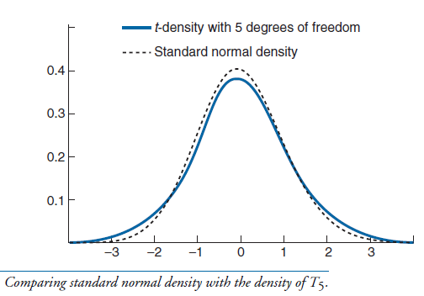
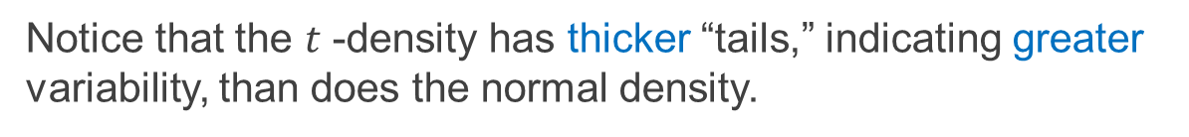
The t-Distribution
Notice that the $t$ -density has thicker “tails,” indicating greater variability, than does the normal density.
Notes:
Bukti menggunakan weak law of large number, Xn/n akan mendekati 1

Slide 34



Confidence Interval for Normal Mean when the Variance is Unknown
Summary, for 100(1 - α)% confidence (σ is unknown)
Two-Sided CI
One-Sided Upper CI
One-Sided Lower CI

Slide 35
Interval Estimates
There are two samples, from two different normal populations.
Confidence Interval for the difference in means of two normal populations, when variances of two populations are known.
Confidence Interval for the difference in means of two normal populations, when variances of two populations are unknown, but equal variances.

Slide 36
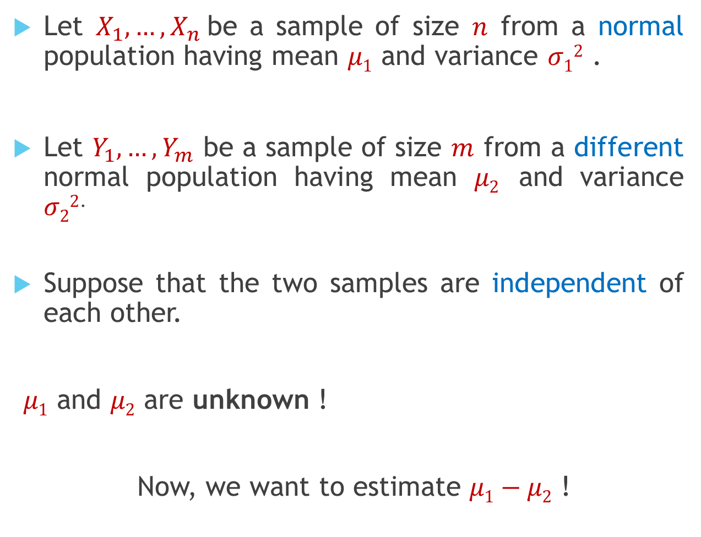
Let $X_{1},…,X_{n}$be a sample of size $n$ from a normal population having mean $μ1$ and variance $σ12$ .
Let $Y_{1},…,Y_{m}$ be a sample of size $m$ from a different normal population having mean $μ2$ and variance $σ22$.
Suppose that the two samples are independent of each other.
$μ1$ and $μ2$ are unknown !
Now, we want to estimate $μ1−μ2$ !
Notes:
Penjelasannya nanti menggunakan gambar !

Slide 37
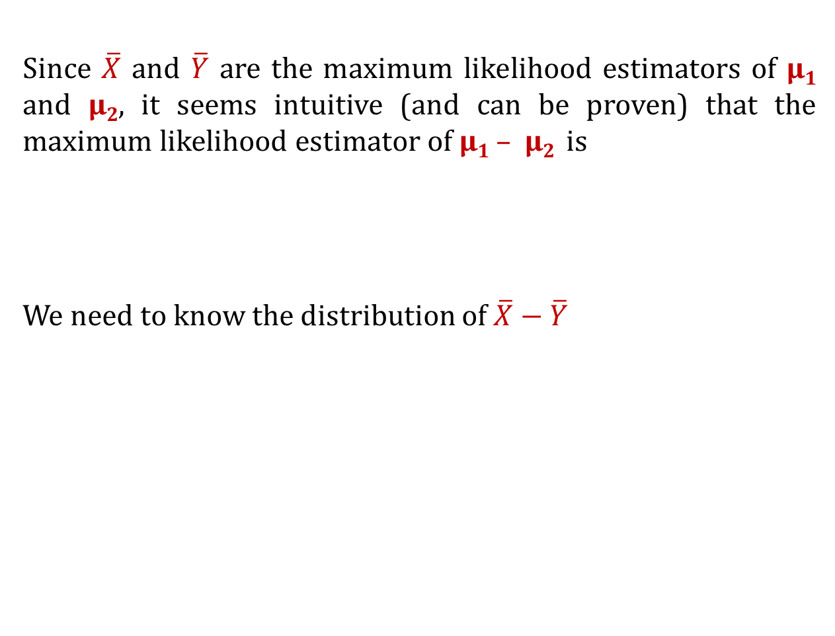
Since $\overline{X}$ and $\overline{Y}$ are the maximum likelihood estimators of μ₁ and μ₂, it seems intuitive (and can be proven) that the maximum likelihood estimator of μ₁ – μ₂ is
We need to know the distribution of $\overline{X}−\overline{Y}$
Hence, by the sum of two independent Normal R.Vs:

Slide 38

When $σ12$ and $σ22$ are known:
In this case, we have
Hence,

Slide 39
When $σ12$ and $σ22$ are known:
Then,
Then, 100(1-α) two-sided confidence interval estimate for μ₁ – μ₂ is
Similar way can be applied for one-sided upper/lower CI.

Slide 40
When $σ12$ and $σ22$ are known:
Then, 100(1-α) two-sided confidence interval estimate for μ₁ – μ₂ is
Then, 100(1-α) one-sided lower CI estimate for μ₁ – μ₂ is
Then, 100(1-α) one-sided upper CI estimate for μ₁ – μ₂ is

Slide 41
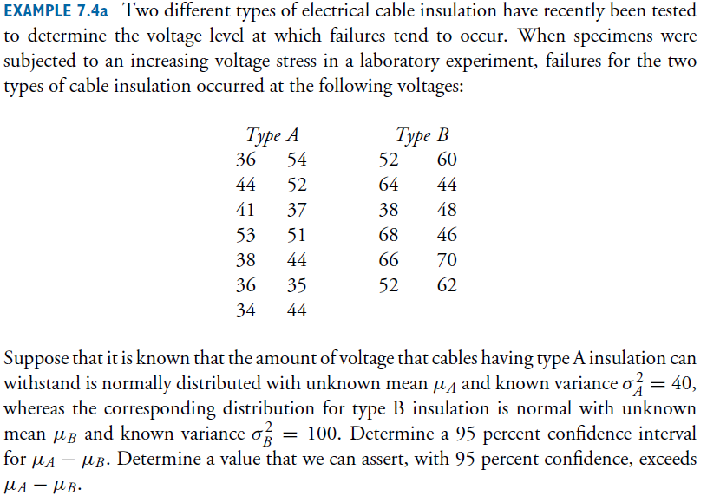

Slide 42
95% two-sided CI:
95% lower CI:
Upper limit

Slide 43

When $σ12$ and $σ22$ are unknown, but$σ12=σ22=σ^{2}$
In this case, the CI can be constructed using the following proposition:
Where, S_{p}² is pooled estimator of σ² :
S₁² and S₂² are sample variances for the first and second sample, respectively.

Slide 44
When $σ12$ and $σ22$ are unknown, but$σ12=σ22=σ^{2}$
Now, we derive the procedure for Confidence Interval
Using the same way as the previous case, we obtain the 100(1-α) two-sided CI for μ₁ – μ₂ when variances are unknown:

Slide 45
When $σ12$ and $σ22$ are unknown, but$σ12=σ22=σ^{2}$
100(1-α) two-sided CI for μ₁ – μ₂ when variances are unknown:
100(1-α) one-sided lower CI for μ₁ – μ₂ when variances are unknown:
100(1-α) one-sided upper CI for μ₁ – μ₂ when variances are unknown:

Slide 46
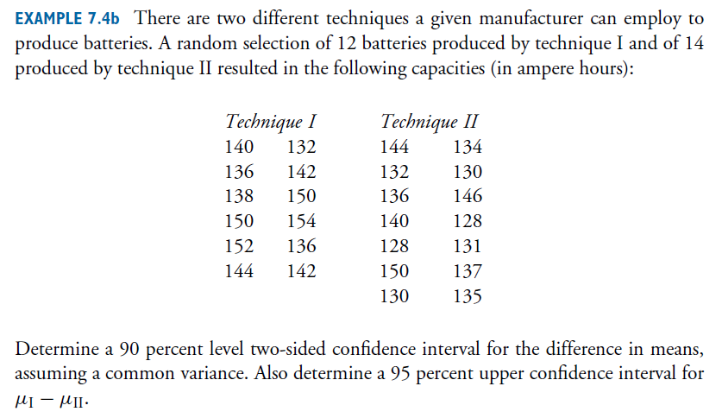

Slide 47
(see Table A3 – t distribution)
90% two-sided CI:
95% upper CI= ?? (we leave this for you ☺)
[Dari slide statprob semester lalu]

Slide 48
Interval Estimates
Approximate Confidence Interval for the Mean of A Bernoulli Random Variable

Slide 49
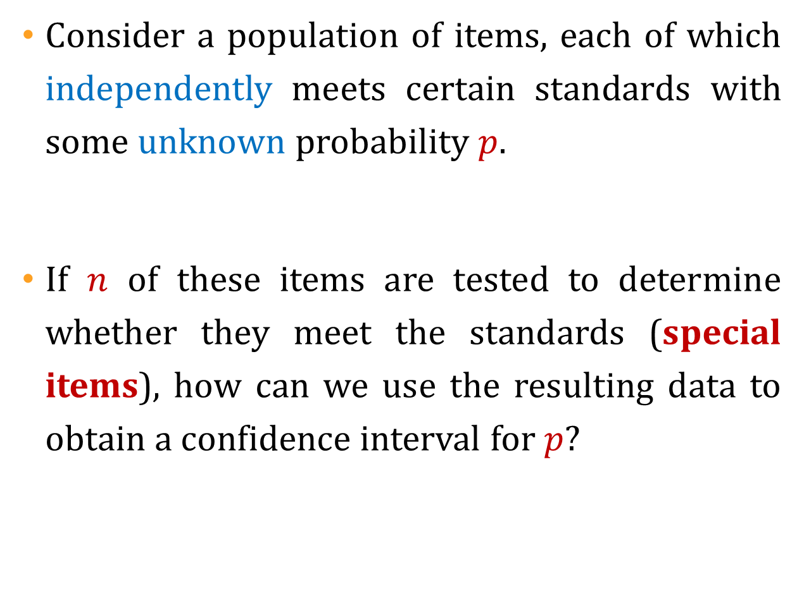
Consider a population of items, each of which independently meets certain standards with some unknown probability $p$.
If $n$ of these items are tested to determine whether they meet the standards (special items), how can we use the resulting data to obtain a confidence interval for $p$?

Slide 50
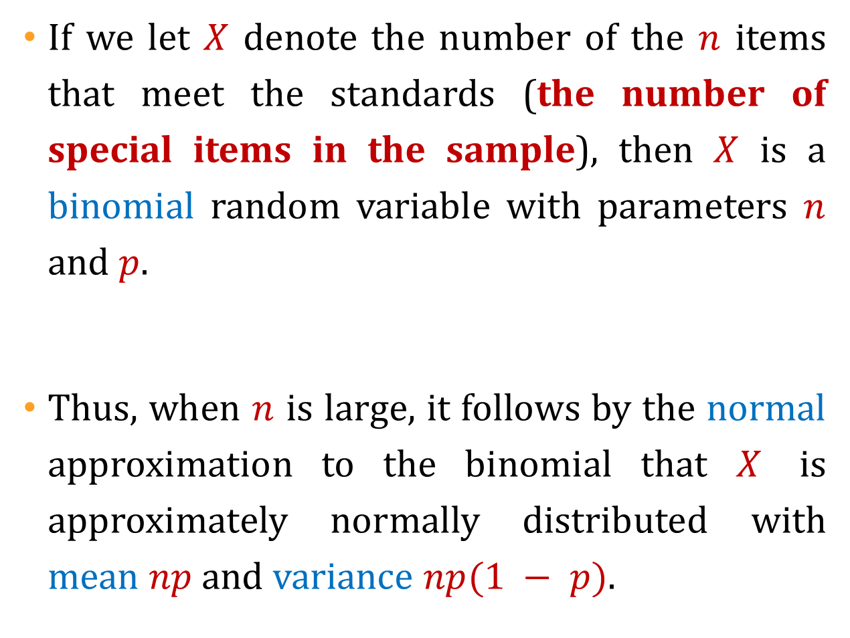
If we let $X$ denote the number of the $n$ items that meet the standards (the number of special items in the sample), then $X$ is a binomial random variable with parameters $n$ and $p$.
Thus, when $n$ is large, it follows by the normal approximation to the binomial that $X$ is approximately normally distributed with mean $np$ and variance $np(1 − p)$.

Slide 51
POPULASI
Special Items
Non-Special Items
proporsi = p
proporsi = 1 – p
Sample of size n
Misal, kita definisikan R.V. X :

Slide 52
X : banyaknya special items pada sample
When n is large, X is approximately normal !
Hence,

Slide 53
is the maximum likelihood estimator of
As a result, we can use the following approximation:
Hence,
Which yields an approximate 100 (1-α)% confidence interval for p

Slide 54
approximate 100 (1-α)% two-sided confidence interval for p
Or, it can be written as
Margin Of Error (MOE)

Slide 55
approximate 100 (1-α)% two-sided confidence interval for p
approximate 100 (1-α)% one-sided lower confidence interval for p
approximate 100 (1-α)% one-sided upper confidence interval for p
is the maximum likelihood estimator of

Slide 56
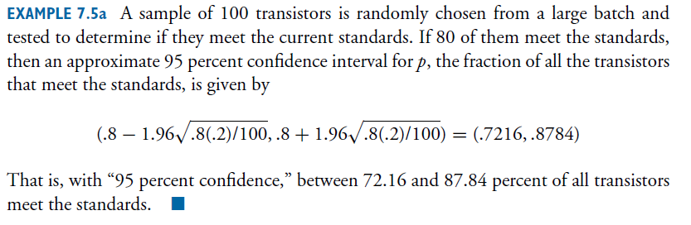

Slide 57
On October 14, 2003, the New York Times reported that a recent poll indicated that 52 percent of the population was in favor of the job performance of President Bush, with a margin of error of +/- 4%
What does this mean ?
Can we infer how many people were questioned ?

Slide 58
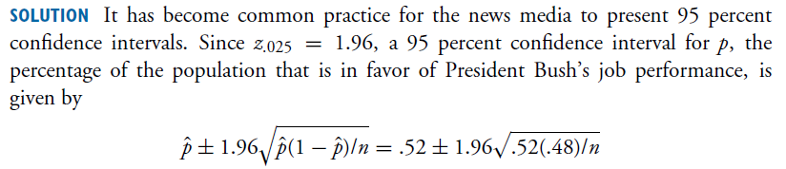
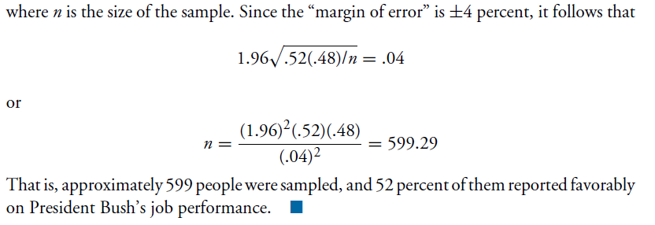

Slide 59
LATIHAN

Slide 60
Diameter logam silinder yang dihasilkan oleh sebuah mesin terdistribusi secara Normal. Sample beberapa potongan diukur dan didapatkan diameternya sebagai berikut (dalam cm):
1.01 0.97 1.03 1.04 0.99 0.98 0.99
1.01 1.03
Tentukan:
99% two-sided CI untuk rataan populasi jika diketahui standar deviasi populasi adalah 0.1 !
Pertanyaan a) tetapi untuk one-sided lower !
99% two-sided CI untuk rataan populasi !

Slide 61
Rata-rata jumlah SKS yang diambil oleh sampel sebanyak 81 mahasiswa FASILKOM adalah 15,6 dengan standar deviasinya adalah 1,8. Buatlah 95% confidence interval untuk rataan jumlah SKS yang diambil oleh SEMUA mahasiswa FASILKOM !

Slide 62
Seorang sarjana teknik sipil ingin menghitung kekuatan dari suatu objek. Sampel acak sebanyak 10 dari tipe pertama menghasilkan data (dalam psi):
3.250 3.268 4.302 3.184 3.266 3.297 3.332 3.502
3.064 3.116
Kemudian, sebanyak 10 sampel dari tipe kedua menghasilkan data:
3.094 3.106 3.004 3.066 2.984 3.124 3.316 3.212
3.380 3.018
Populasi dari 2 tipe tersebut mempunyai distribusi Normal dan memiliki variansi yang sama.
Estimasi perbedaan rataan dari 2 populasi tersebut dengan CI 95% one-sided lower !

Slide 63
Nilai siswa di SMA A dan SMA B diketahui mengikuti distribusi normal dengan masing mempunyai standar deviasi 15,8 dan 12,3. Tetapi, rataannya tidak diketahui.
Misal, ada 2 kelompok sampel dari masing-masing SMA. Sampel 1 berisi 38 siswa dari SMA A, dan Sampel 2 berisi 48 siswa dari SMA B. Tujuan kita adalah untuk estimasi perbedaan rataan nilai antara dua SMA.
Rataan sampel 1 = 88,5
Rataan sampel 2 = 74,5
Tentukan 98% confidence interval untuk perbedaan rataan antara dua SMA tersebut !
Notes:
(6.7467, 21.253)

Slide 64
Sebuah pabrik semikonduktor memproduksi chip dan bagian quality control ingin meneliti kualitas chip yang dihasilkan.
Jika sebanyak 100 chip dipilih secara acak dan ditemukan 10 chip yang rusak, tentukan CI 95% untuk presentase chip yang rusak yang dihasilkan pabrik ini !
Jika perusahaan melaporkan bahwa 5% chip mereka rusak dengan margin error 1% untuk CI 95%, berapa banyak sampel yang mereka ambil ?

